Slide 1
SQL Data operations

Slide 2
Commands for adding, deleting, and updating data
SQL language is not only used to select data, it can also be used to modify DB content. The commands that allow you to modify DB content are follows:
Insert - Adds new data Update - Changes the table data Delete deletes rows from the table

Slide 3
Commands for adding, deleting, and updating data
These commands do not display any result but return an information about how successful the command was. Unlike the Select command, the Insert, Delete, and Update commands change DB data. Therefore, the DB administrator may not allow it.
To use the Insert, Delete, and Update commands, you need to know the following information about the columns in the table:
column names
column order
column data types
primary key columns
whether the column values ​​must be unique
whether a NULL value in the columns is allowed
column value by default

Slide 4
INSERT
The command adds new rows to the table. This command can be used:
to insert a row using a column order (Insert Values ​​format)
to insert a row using column names (Insert ColumnNames Values ​​format)
to insert rows from another table (Insert Select format)

Slide 5
INSERT
Add rows using a column order
Format:
INSERT INTO table VALUES (value1, ..., value n);
In this case, the number of values ​​is equal to the number of columns, and the values order need to correspond the column names order ​​in the table. The value data types must be the same as the table column data types.

Slide 6
INSERT
Add rows by using column names Format: INSERT INTO (column name1, ..., column name n) VALUES (value1, ..., value n); The number of values must be the same as the number of column names. Values order must be the same as column name order. You can type column names in arbitrary order. If a column name is omitted, its value becomes NULL.

Slide 7
INSERT
Add rows from another table Format: INSERT INTO [(column name1, ..., column name n)] SELECT statement; The number of columns in the Select statement must be the same as the number of columns in the table, or the number of columns in the list that follows the INTO keyword. If the column name is not in the list, its value becomes NULL.

Slide 8
Commands for adding, deleting, and updating data
Examples: Add a new row to Books by using the column order INSERT INTO Books VALUES (59, 'Jauna', 'Jaunums', 5);
Add a new row to the Readers table by using column names INSERT INTO Readers (ReaderID, ReaderSur, ReaderName) VALUES ('2222/22', 'Jauns', 'Janis');

Slide 9
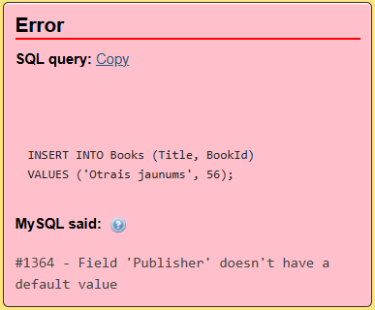
Commands for adding, deleting, and updating data
Examples: Add a new row to Books table by using column names INSERT INTO Books (Title, BookId)
VALUES ('Otrais jaunums', 56);
???

Slide 10
Commands for adding, deleting, and updating data
Examples: Give a specific reader a new books (1)
INSERT INTO Books_taken (BookId, ReaderID, ReturnDate)
SELECT b.BookId, r.ReaderID, DATE_ADD(CURDATE(), INTERVAL 14 DAY)
FROM Books b CROSS JOIN Readers r
WHERE (Title LIKE 'Jauna') AND (ReaderSur LIKE 'Jauns');
INTERVAL 14 DAY Today's date and time + 14 days

Slide 11
Commands for adding, deleting, and updating data
Examples: Give a specific reader a new books (2)
INSERT INTO Books_taken (BookId, ReaderID, ReturnDate)
SELECT b.BookId, r.ReaderID, DATE_ADD(CURDATE(), INTERVAL 14 DAY)
FROM Books b, Readers r
WHERE (Title LIKE 'Jauna') AND (ReaderSur LIKE 'Jauns');
INTERVAL 14 DAY Today's date and time + 14 days

Slide 12
Commands for adding, deleting, and updating data
Examples: Give a specific reader a new books (3)
INSERT INTO Books_taken (BookId, ReaderID, ReturnDate)
SELECT b.BookId, r.ReaderID, DATE_ADD(CURDATE(), INTERVAL 14 DAY)
FROM Books b INNER JOIN Readers r ON 1=1
WHERE (Title LIKE 'Jauna') AND (ReaderSur LIKE 'Jauns');
INTERVAL 14 DAY Today's date and time + 14 days

Slide 13
DELETE
With the Delete command, you can delete: - all the rows in the table - individual rows in a table The Delete command does not delete the table itself. You can delete the table by using the Drop Table command. Format: DELETE FROM table [WHERE condition];

Slide 14
Commands for adding, deleting, and updating data
Examples: Delete books taken by a specific reader
DELETE *
FROM Books_taken
WHERE ReaderID LIKE '3524/8r';
or
DELETE *
FROM Books_taken
WHERE ReaderID = (
SELECT ReaderID
FROM Readers
WHERE (ReaderSur LIKE 'Jauns')
);

Slide 15
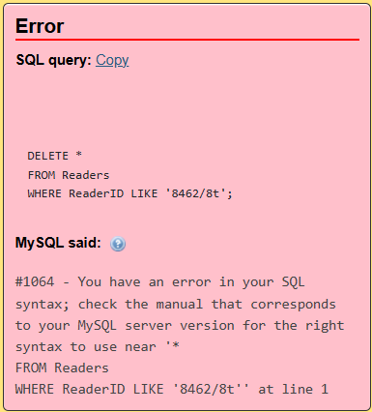
Commands for adding, deleting, and updating data
Examples: Delete reader
DELETE *
FROM Readers
WHERE ReaderID LIKE '8462/8t';

Slide 16
Commands for adding, deleting, and updating data
Examples: Delete reader
DELETE *
FROM Books_taken
WHERE ReaderID LIKE '8462/8t';
DELETE *
FROM Readers
WHERE ReaderID LIKE '8462/8t';

Slide 17
UPDATE
Update command updates: - all the row values in the table - individual rows in a table Format: UPDATE table SET column1=value1, ..., column n=value n [WHERE condition];

Slide 18
Commands for adding, deleting, and updating data
Examples: Change reader's address
UPDATE Readers
SET Town='Riga', Street='Dzirnavu', House='25', Flat='17', PhoneNum='12345678'
WHERE ReaderID LIKE '2222/22';

Slide 19
Practice
Delete Librarian ' Linda Pacuka ' Delete librarians who did not provide any services (it will be 'Agafonova'). Increase the number of copies by 3, for books the number of copies of which <3. To all readers from Riga (to whom it has not yet been issued) issue (INSERT) a book "Nogalinat lakstigalu" "Liesma"

Slide 20
Answers
1.
1.1.
DELETE *
FROM Journal
WHERE LibId LIKE (
SELECT LibId
FROM Librarians
WHERE LSur = 'Pacuka'
);
1.2.
DELETE *
FROM Librarians
WHERE LSur LIKE 'Pacuka';
2.
DELETE *
FROM Librarians l
WHERE NOT EXISTS (
SELECT *
FROM Journal j
WHERE l.LibId = j.LibId
);

Slide 21
Answers
3.
UPDATE Books
SET NUmOfCopies = NUmOfCopies + 3
WHERE NUmOfCopies < 3;
4.
INSERT INTO Books_taken (ReaderID, BookId, ReturnDate)
SELECT r.ReaderID, b.BookId, DATE_ADD(CURDATE(), INTERVAL 14 DAY)
FROM Books b, Readers r
WHERE r.Town = "Riga" AND b.BookId = 62 AND NOT EXISTS (
SELECT 1
FROM Books_taken bt
WHERE bt.BookId = 62 AND bt.ReaderID = r.ReaderID
);

